Slide 1
COMP 7570 Presentation
Presented By
Md. Monowar Anjum
Student Id: 7896967

Slide 2
Paper 1: Understanding Ethereum Via Graph Analysis Chen, T., Li, Z., Zhu, Y., Chen, J., Luo, X., Lui, J. C. S., Zhang, X et. al. ACM Transactions on internet technology (2020)
General Overview:
Ethereum is a blockchain platform
There are two types of nodes in the Ethereum blockchain. Externally Owned Accounts and Smart Contracts
The currency is known as Ether/Tokens
Currently the second blockchain network in terms of market capitalization. ( i.e. Massive Graph)
Graph data structure is a collection of nodes and edges
Degree of a node is the number of nodes it is connected to
Indegree is the number of incoming edges in a node
Outdegree is the number of outgoing edges in a node
Strongly connected component is a set of nodes in the graph where there is a path from any node to another node

Slide 3
Paper 1: Understanding Ethereum Via Graph Analysis
MFG: Money Flow Graph
- This is a graph where each vertices are either an EOA or a smart contract and the edge weights are the amount transferred.
CCG: Contract Creation Graph
- this graph contains the creation of the contracts information. If contract 1
Creates contract 2 then there is a directed edge between contract 1 and 2.
CIG: Contract Invoke Graph
- The contract invoke graph contains information of the times contracts invoke each other. The direction is the invoking direction and the edge of the weight is the times the caller calls the callee contract.

Slide 4
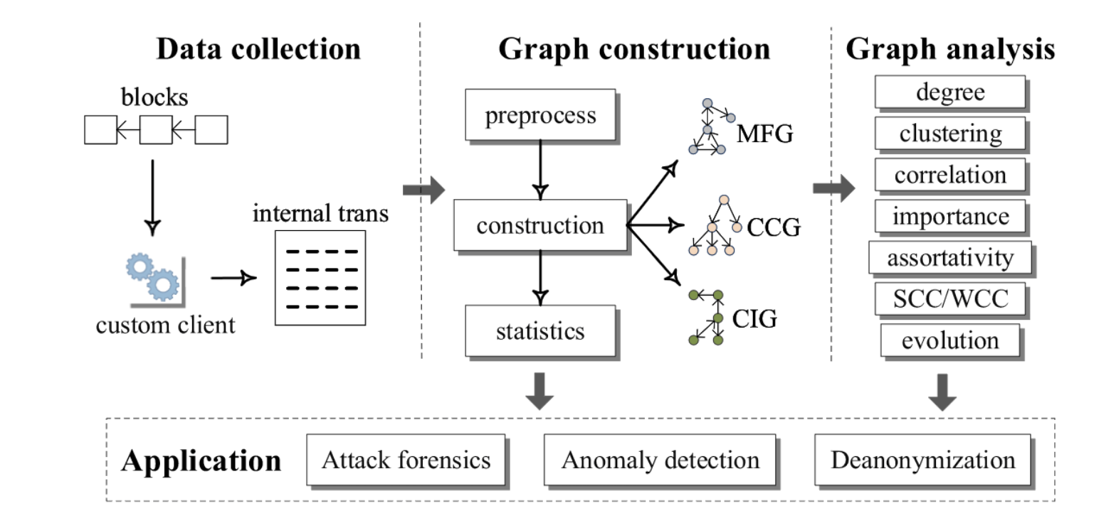
Paper 1: Understanding Ethereum Via Graph Analysis

Slide 5
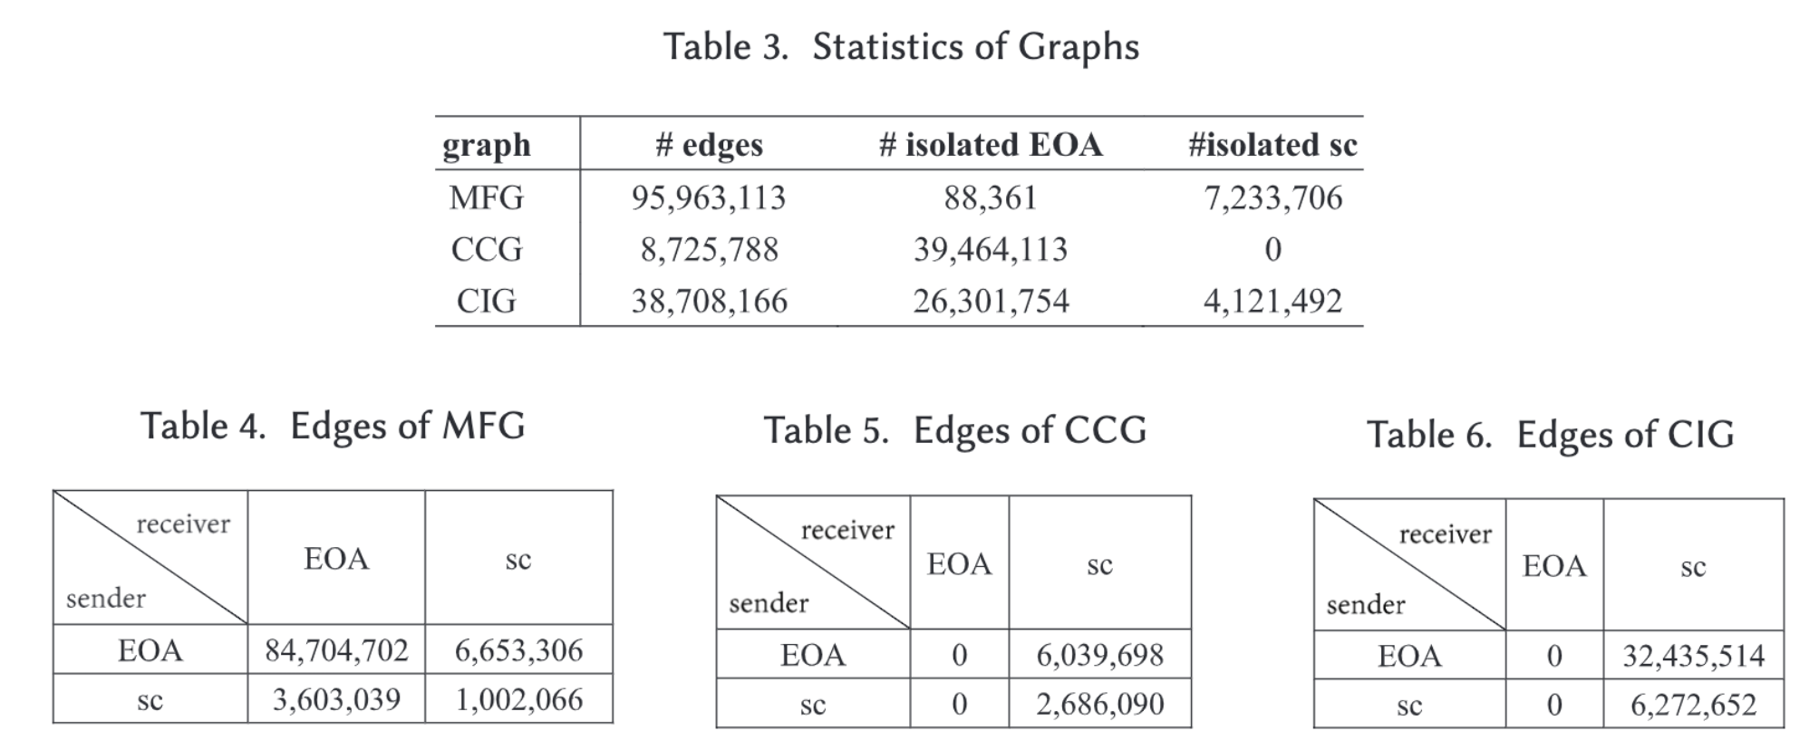
Paper 1: Understanding Ethereum Via Graph Analysis
Majority of the ether transactions take place between EOAs
Majority of smart contracts do not transfer ether
99.7% of the EOA do not create contracts, 66% EOAs do not invoke them and 47% of smart contracts are never invoked
88% edges in MFG are between EOAs where 84% edges in CIG and CCG are from EOA to smart contracts.

Slide 6
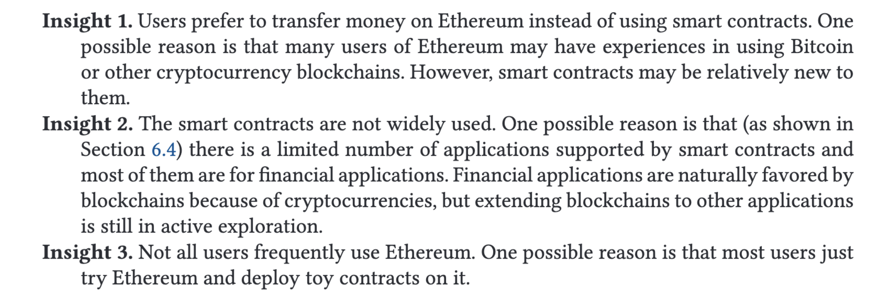
Paper 1: Understanding Ethereum Via Graph Analysis
Insights from the statistics of the MFG, CIG, CCG:

Slide 7
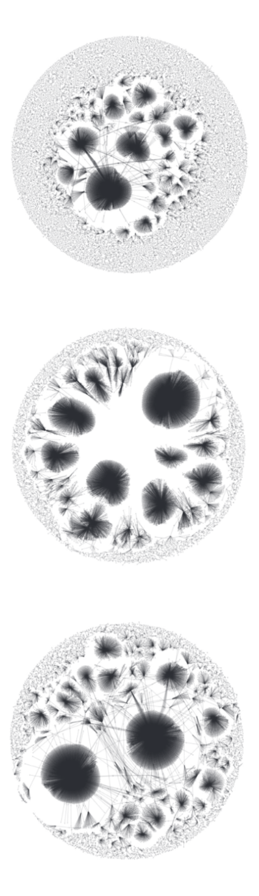
Paper 1: Understanding Ethereum Via Graph Analysis
Metrics to analyze the graphs:
Clustering Coefficient, Pearson Coefficient
SCC, WCC
Importance (Page Rank)
Ether Between Two account
Common Edges

Slide 8
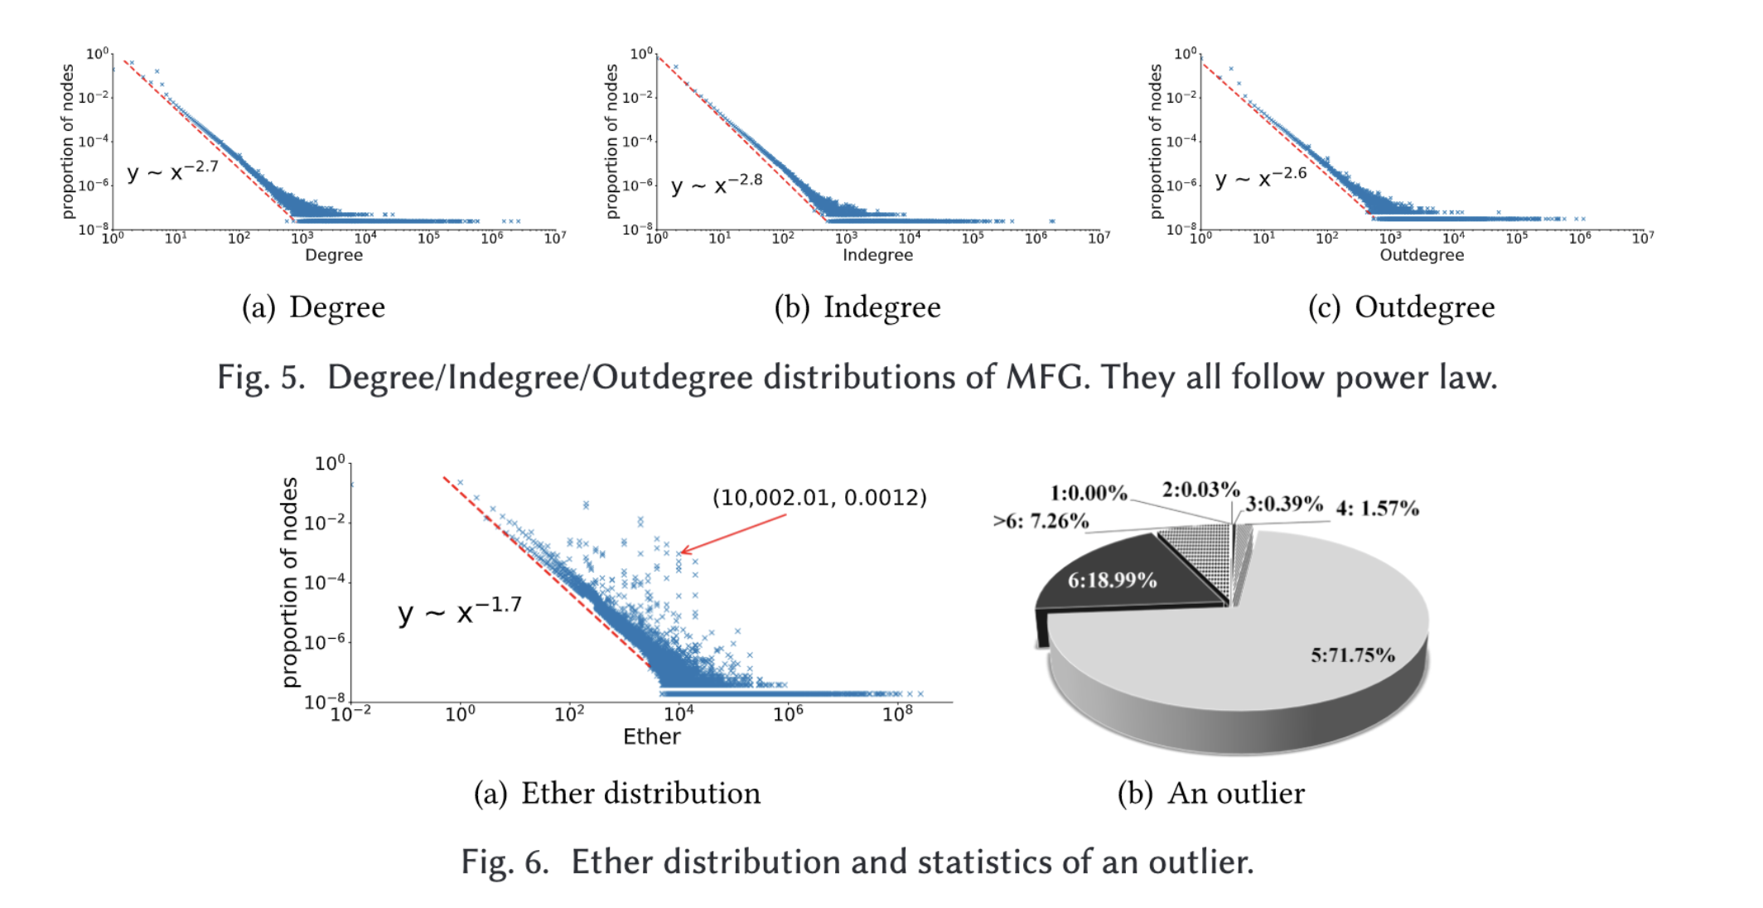
Paper 1: Understanding Ethereum Via Graph Analysis

Slide 9
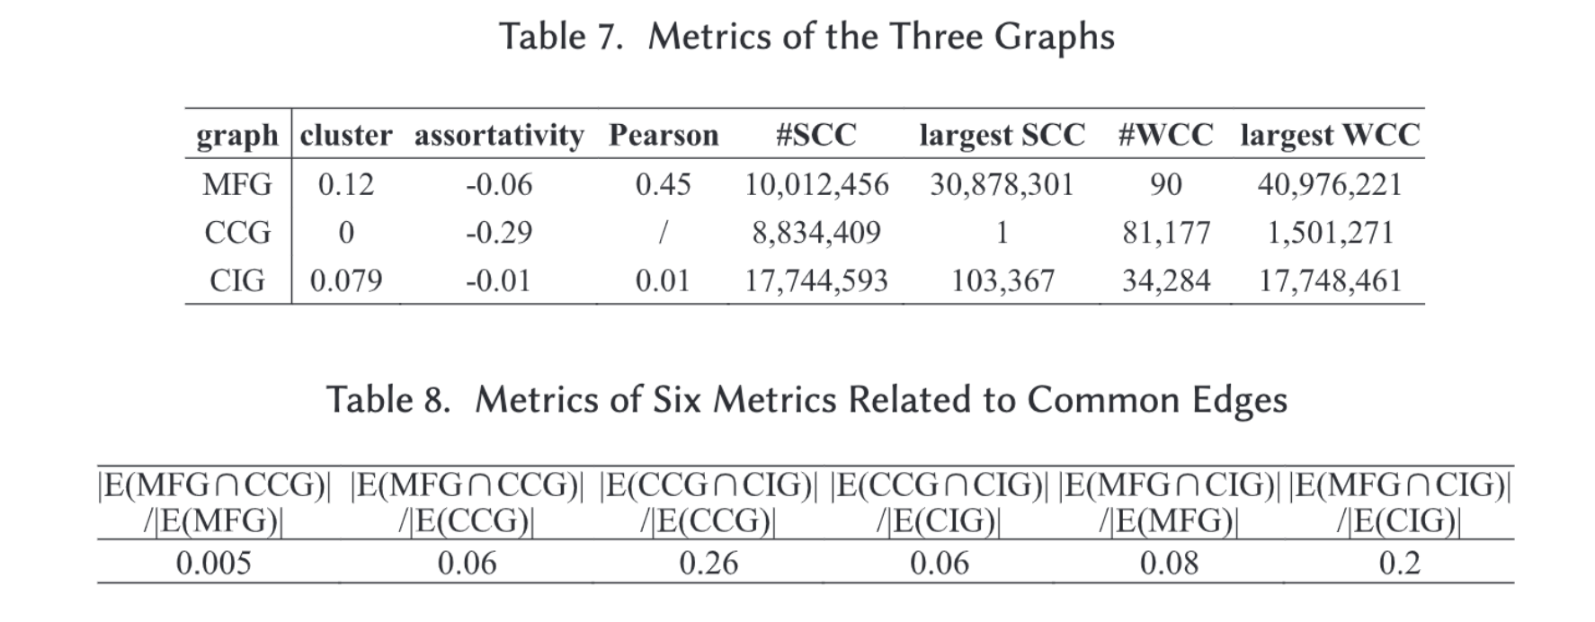
Paper 1: Understanding Ethereum Via Graph Analysis

Slide 10
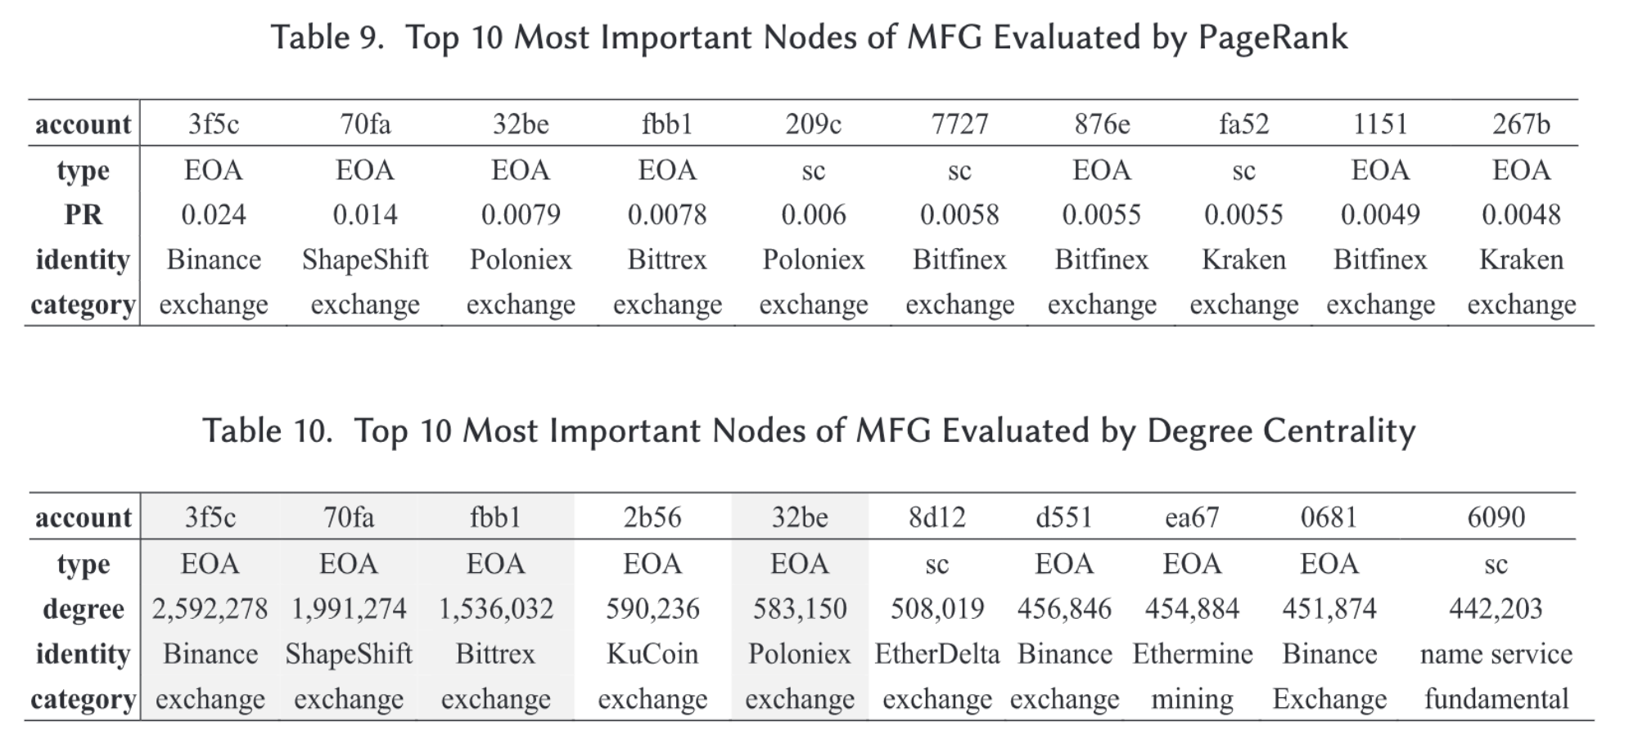
Paper 1: Understanding Ethereum Via Graph Analysis

Slide 11
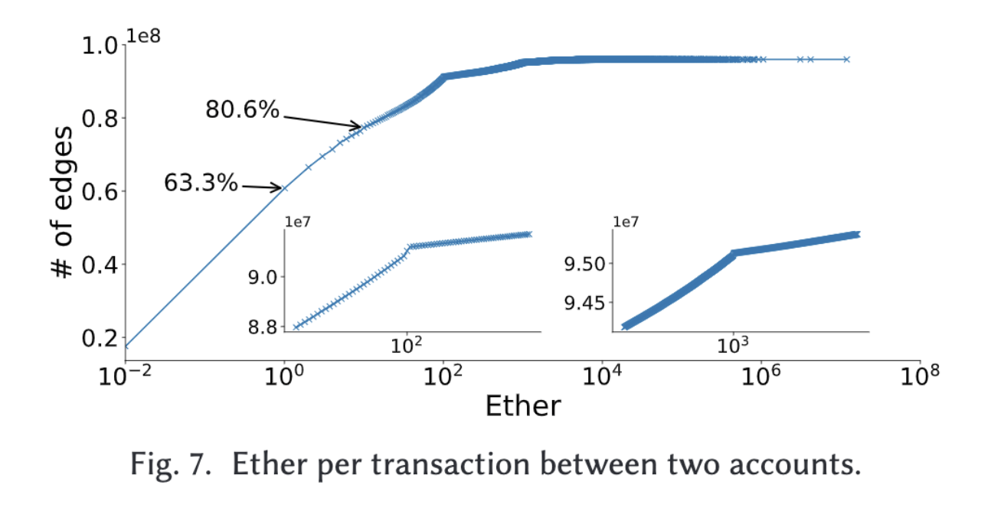
Paper 1: Understanding Ethereum Via Graph Analysis

Slide 12
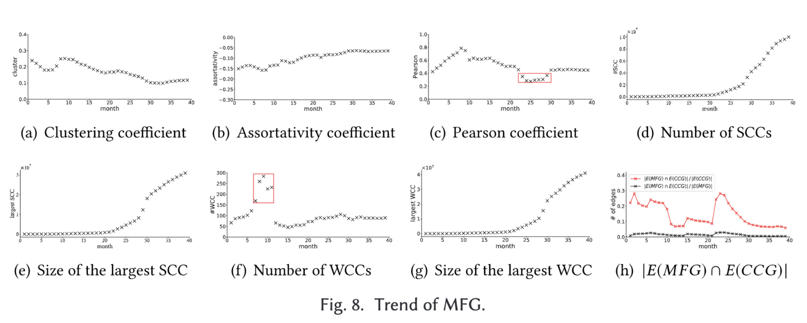
Paper 1: Understanding Ethereum Via Graph Analysis

Slide 13
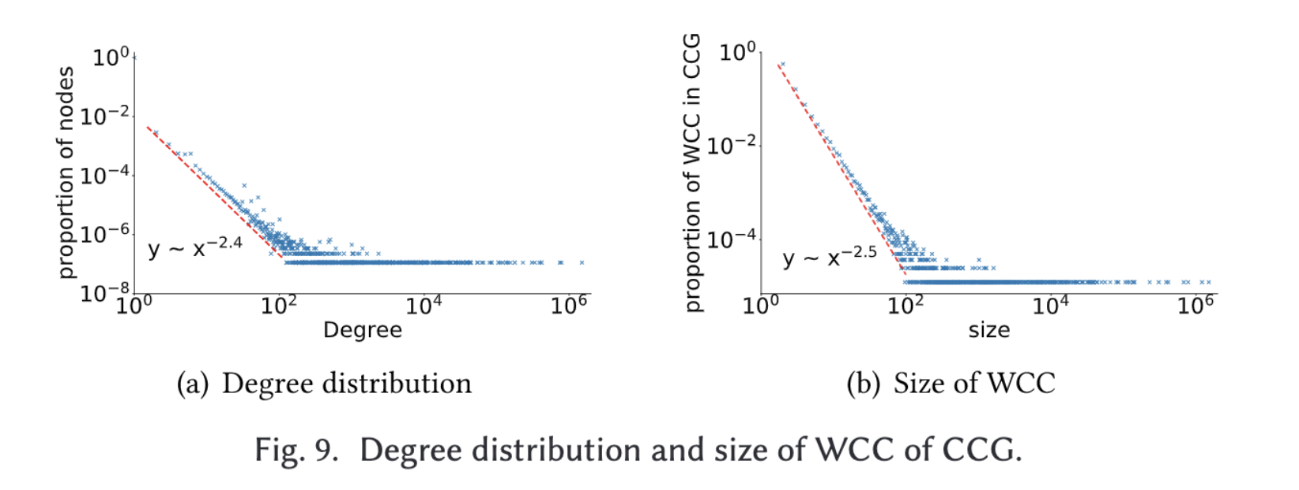
Paper 1: Understanding Ethereum Via Graph Analysis

Slide 14
Paper 1: Understanding Ethereum Via Graph Analysis

Slide 15
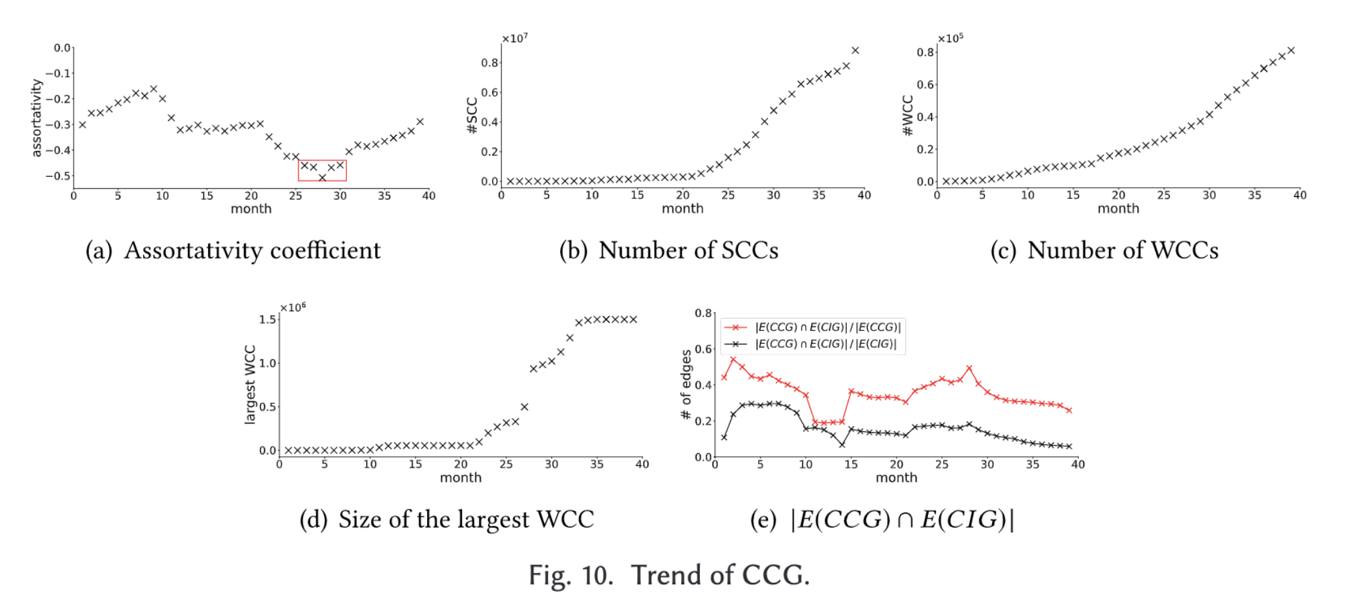
Paper 1: Understanding Ethereum Via Graph Analysis

Slide 16
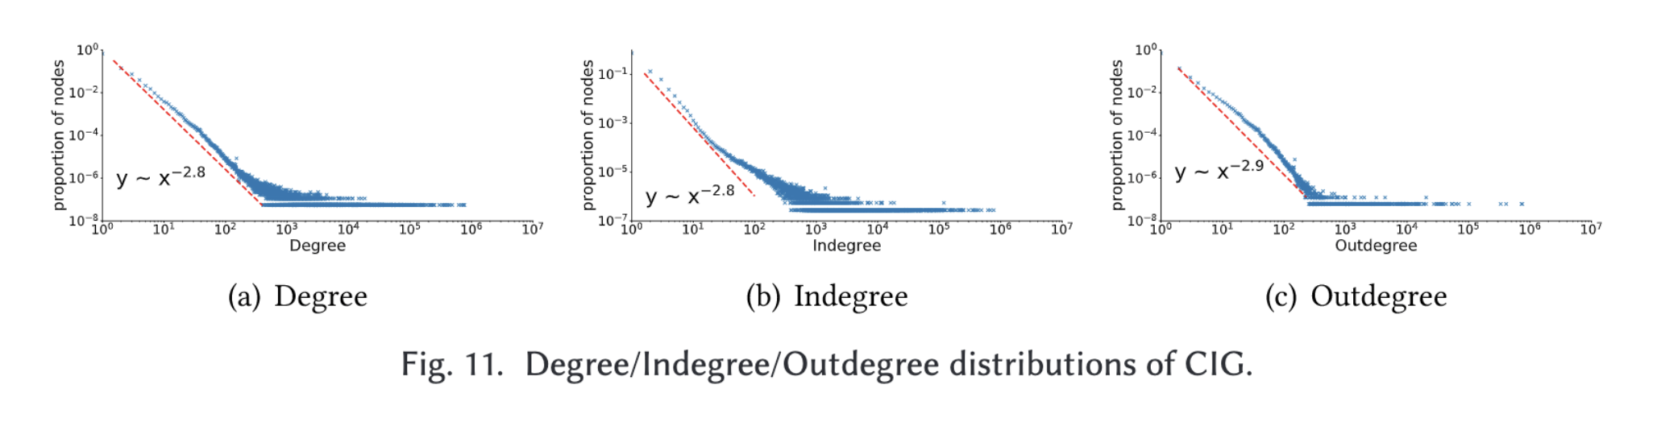
Paper 1: Understanding Ethereum Via Graph Analysis

Slide 17
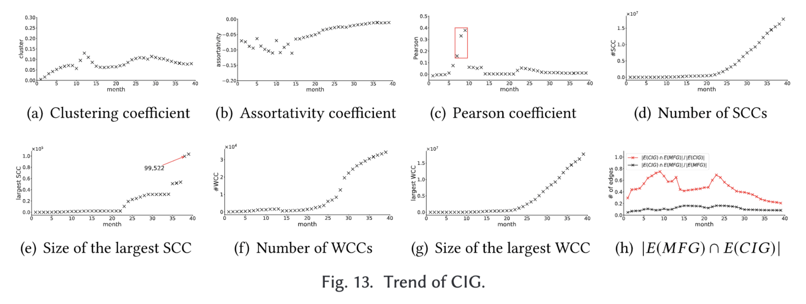
Paper 1: Understanding Ethereum Via Graph Analysis

Slide 18
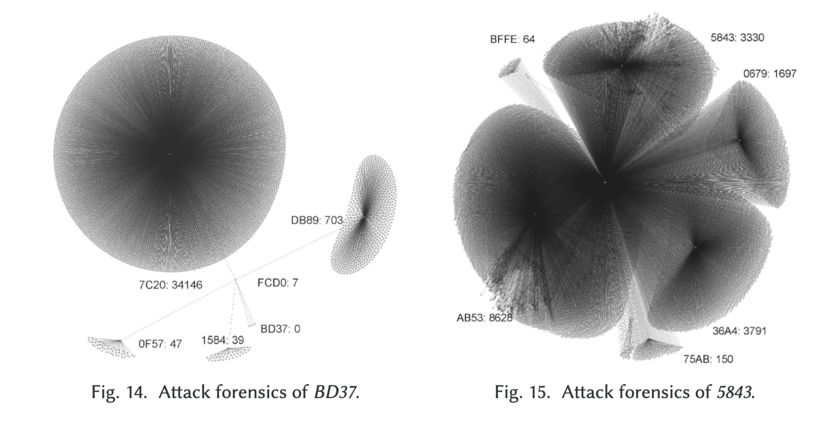
Paper 1: Understanding Ethereum Via Graph Analysis
Attack forensics analysis: DDoS attack

Slide 19
Paper 1: Understanding Ethereum Via Graph Analysis
Attack forensics analysis: DDoS attack

Slide 20
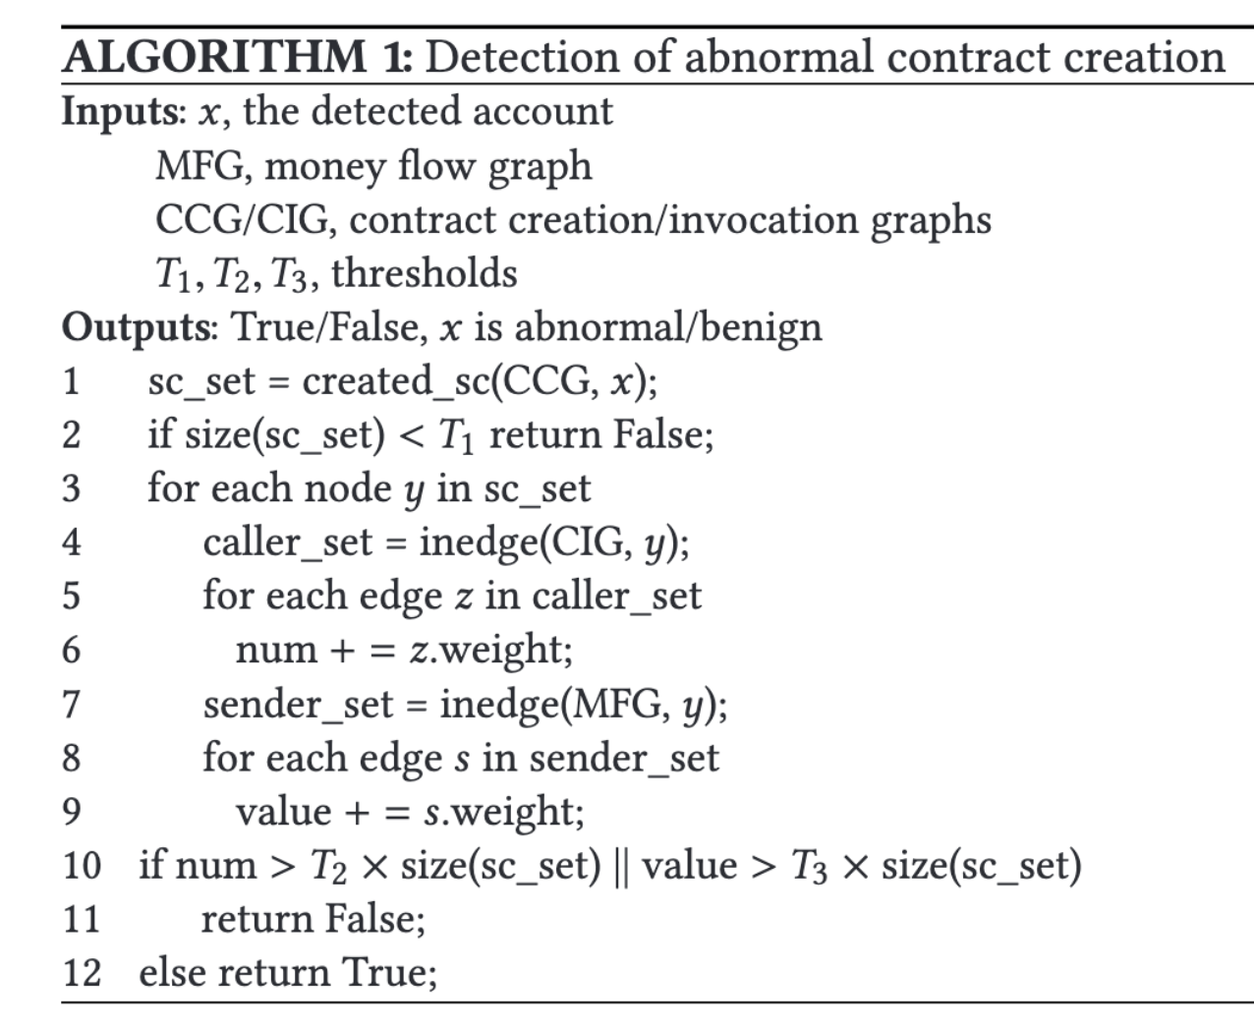
Paper 1: Understanding Ethereum Via Graph Analysis
Attack forensics analysis: DDoS attack
Key points: There are 3 Threshold values. T1, T2, T3
First Check: If the number of created smart contract is more than T1
Second Check:
Num = total number of invocation in the CIG
Sum = Total amount of money transfer in MFG
If Num*(set_count)+Sum*(set_count) is below Threshold in both cases then this WCC is abnormal

Slide 21
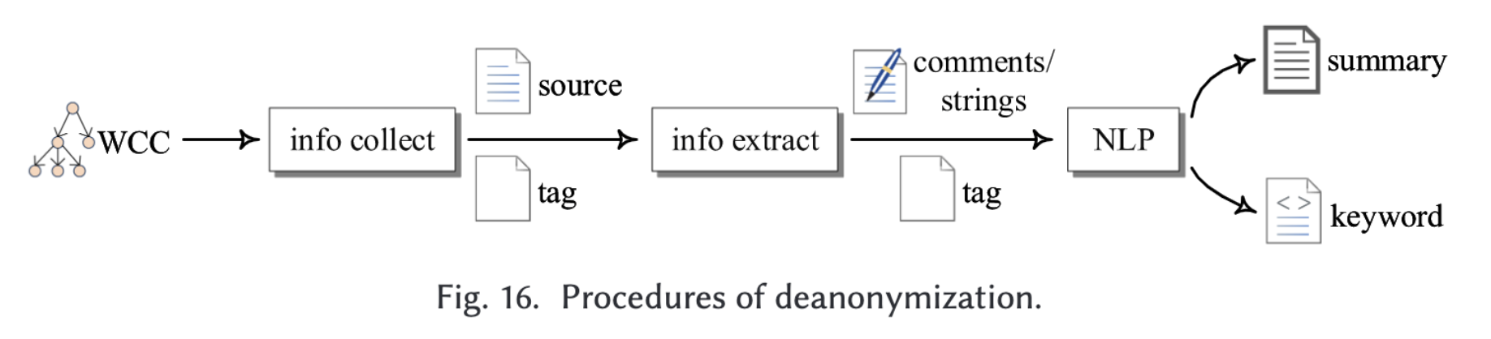
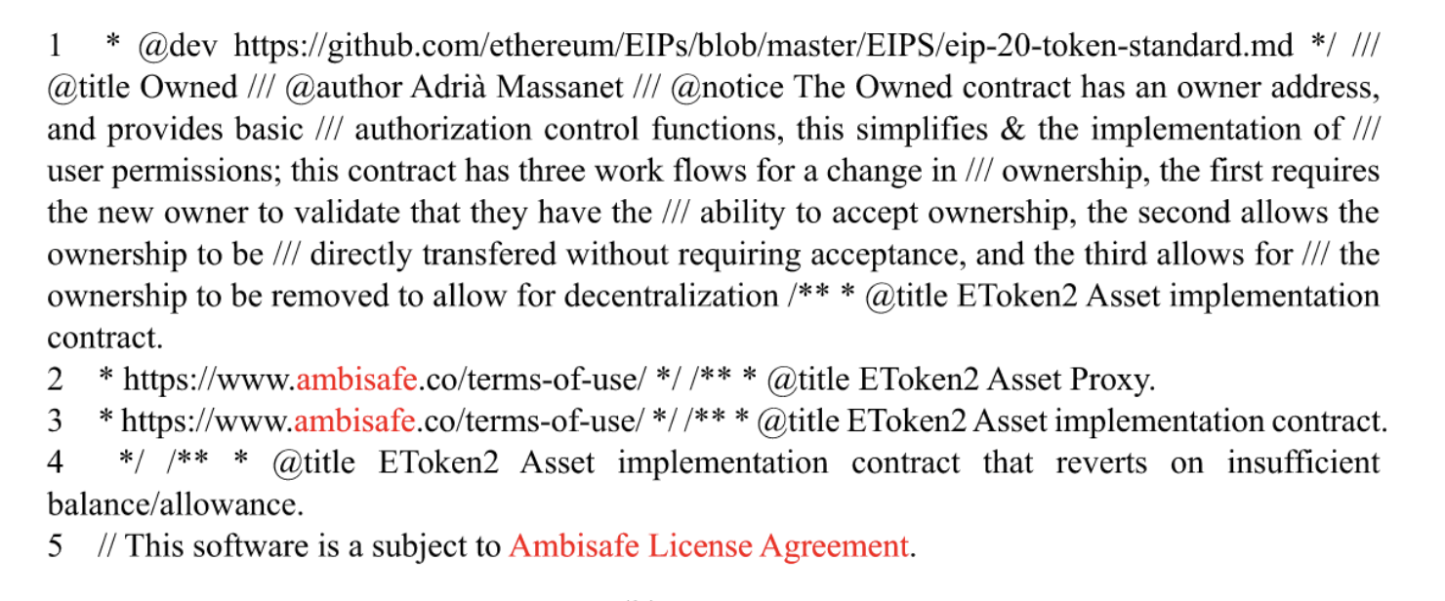
Paper 1: Understanding Ethereum Via Graph Analysis
Based on the extracted tokens in the NLP process, we can identify possible information that might reveal the identity of the transaction participant.

Slide 22
Question
What’s wrong with the deanonymization attack?

Slide 23
Paper 2:Forecasting Bitcoin Price with graph chainlet Cuneyt Gurcan Akcora, Asim Kumar Dey, Yulia R Gel, Murat Kantarcioglu In Pacific-Asia Conference on Knowledge Discovery and Data Mining (pp. 765-776)
The bitcoin is a blockchain based cryptocurrency which currently holds the highest market capitalization among all the cryptocurrencies
Bitcoin price is very volatile and prone to massive swing in short period of time
Bitcoin blockchain has three type of building blocks: Transaction, block and address.
Bitcoin Blockchain can be modeled as a directed graph

Slide 24
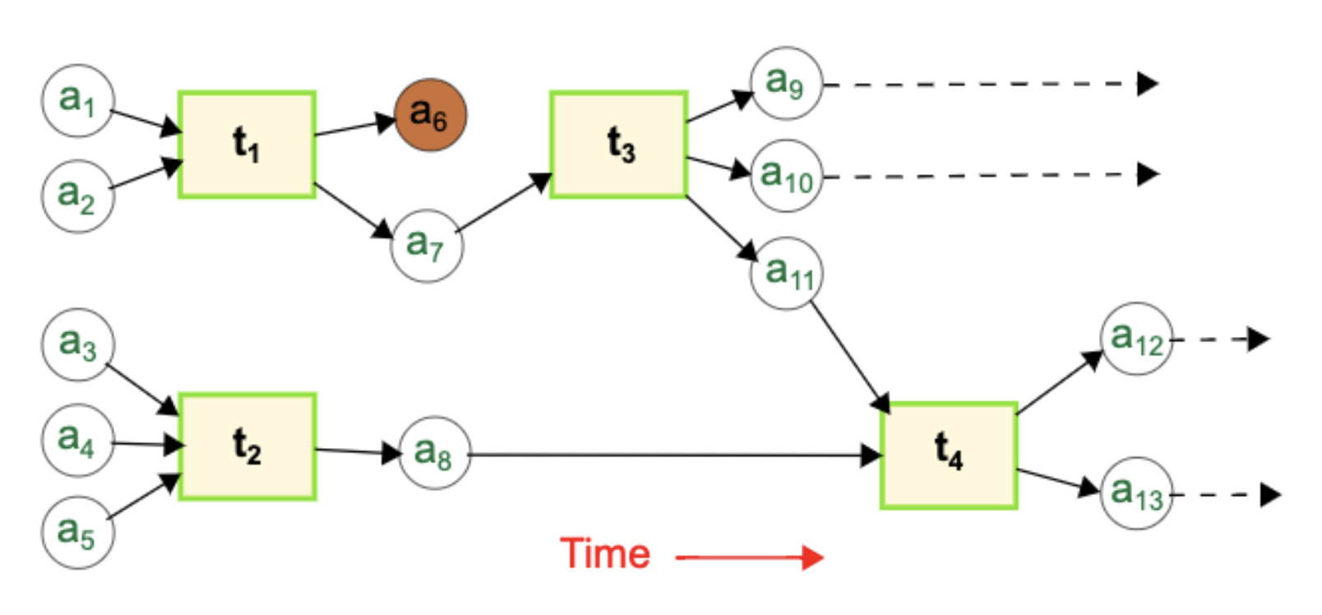
Paper 2:Forecasting Bitcoin Price with graph chainlet

Slide 25
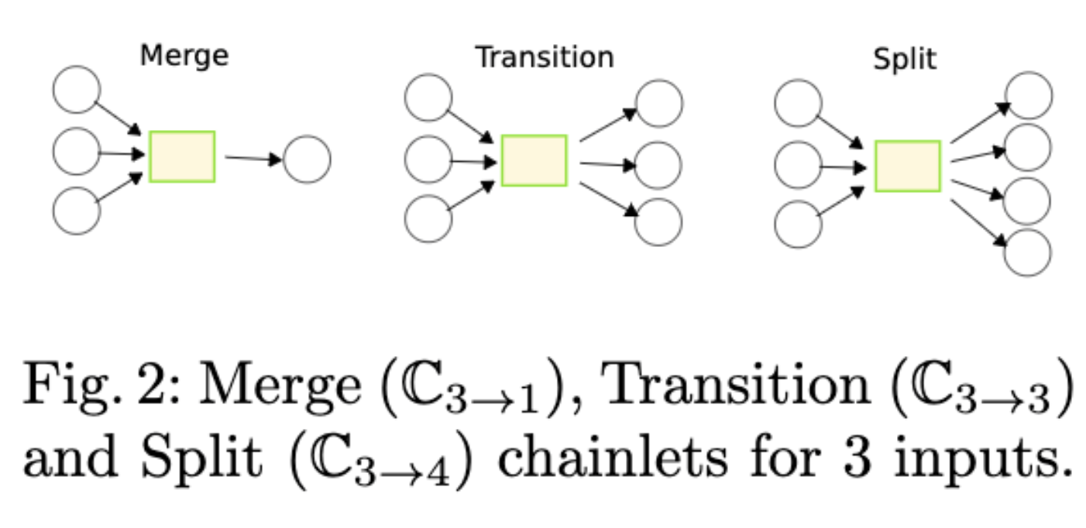
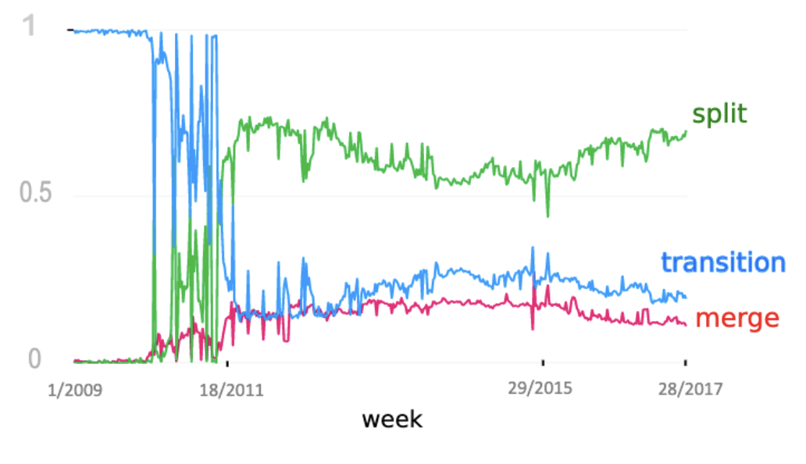
Paper 2:Forecasting Bitcoin Price with graph chainlet
Chainlets can be viewed a re-occurring subgraph in the global graph. They hold local topological properties which can be essential and useful in developing forecasting models.

Slide 26
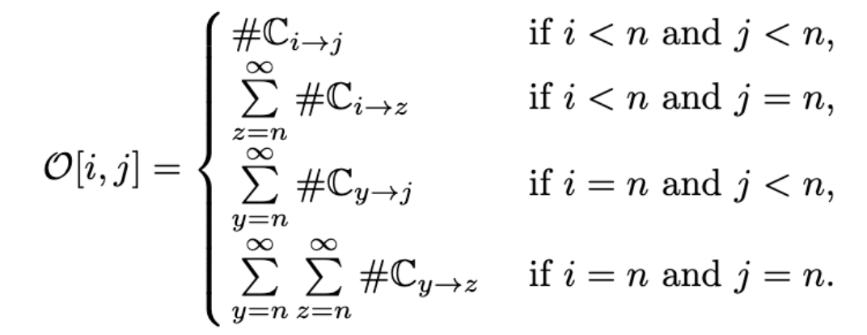
Paper 2:Forecasting Bitcoin Price with graph chainlet
[20 10 9 30]. This is what a 4*4 daily snapshot of
[2 4 7 8] data based on chainlet may look like
[10 11 8 1 ]
[20 15 8 19]

Slide 27
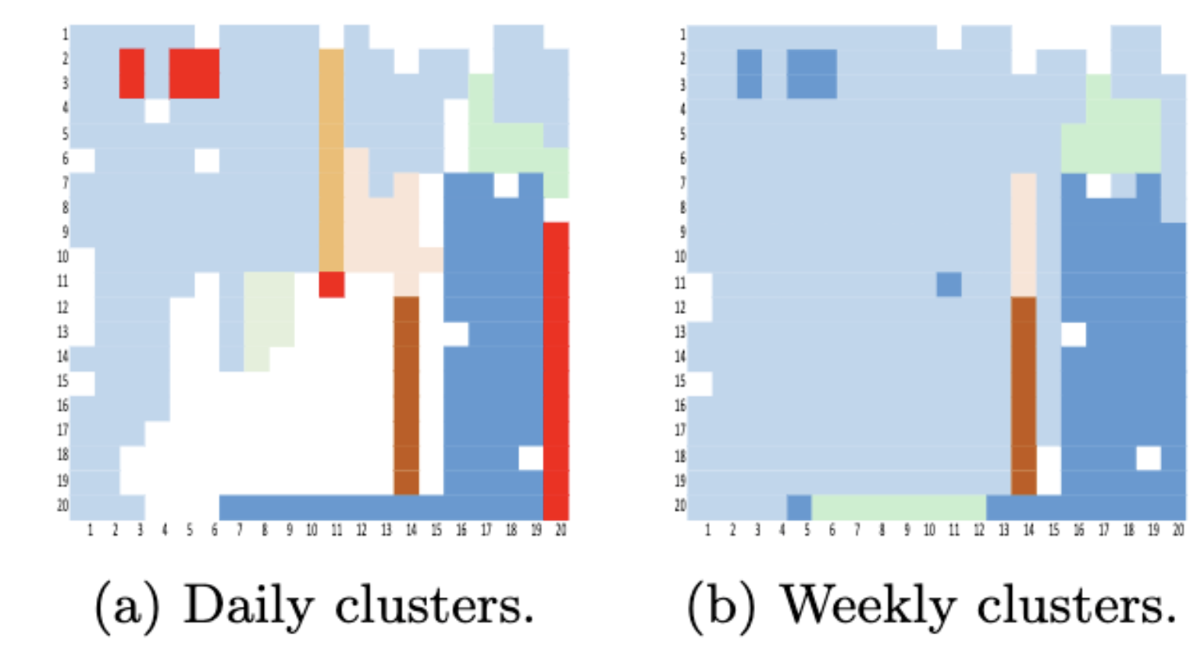
Paper 2:Forecasting Bitcoin Price with graph chainlet

Slide 28
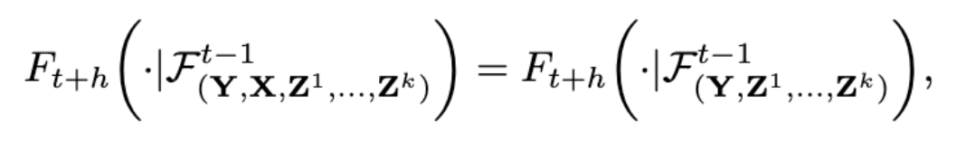
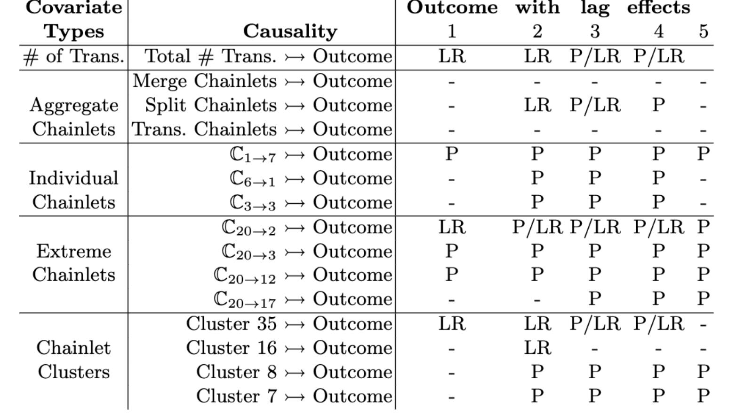
Paper 2:Forecasting Bitcoin Price with graph chainlet

Slide 29
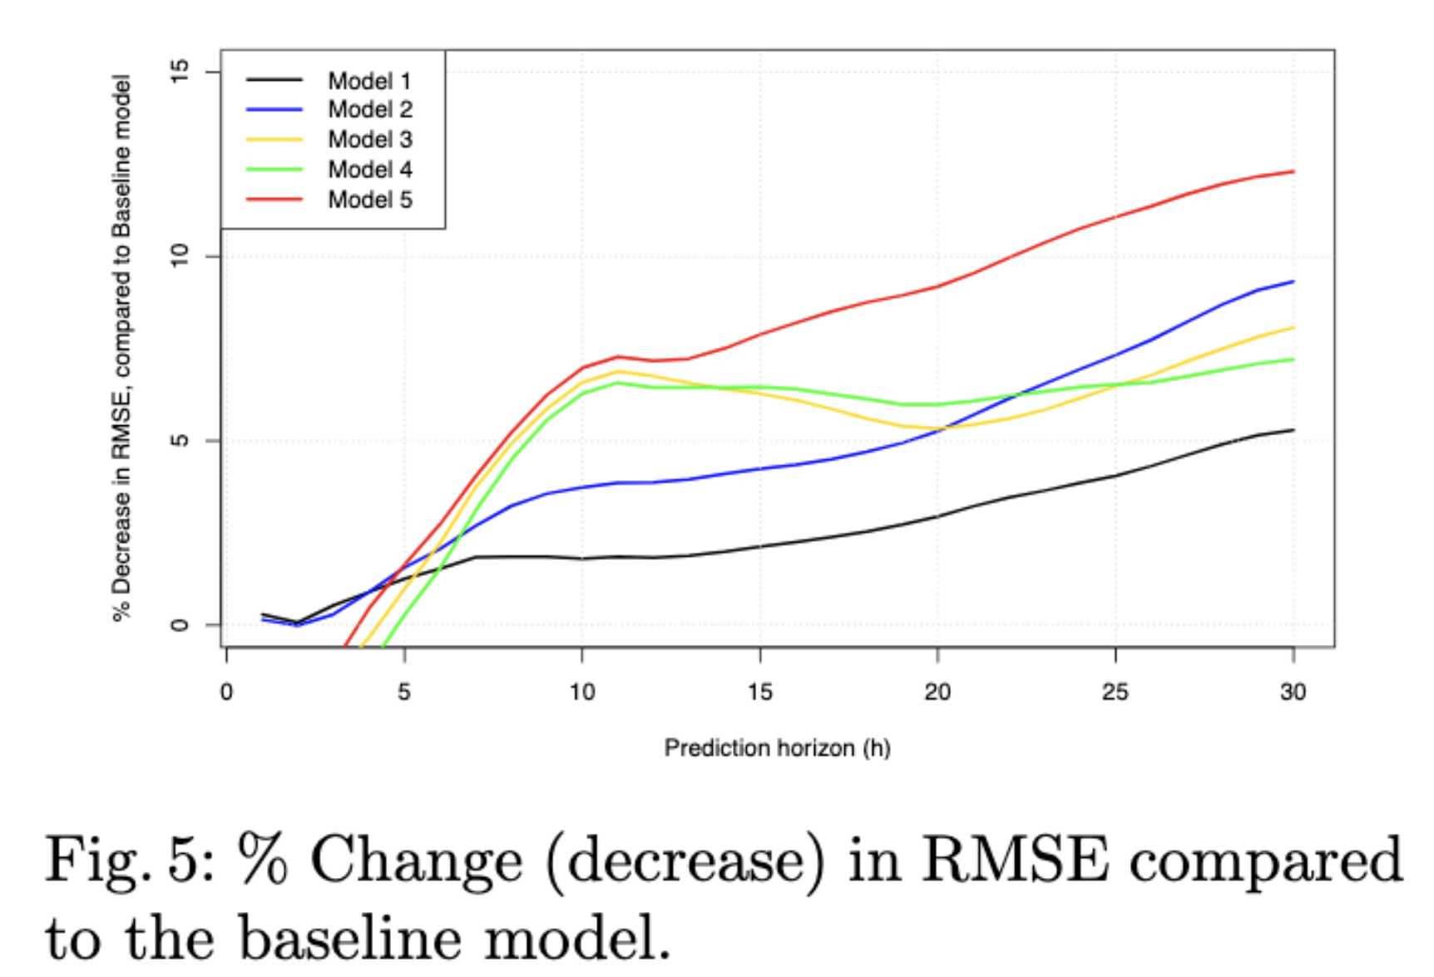
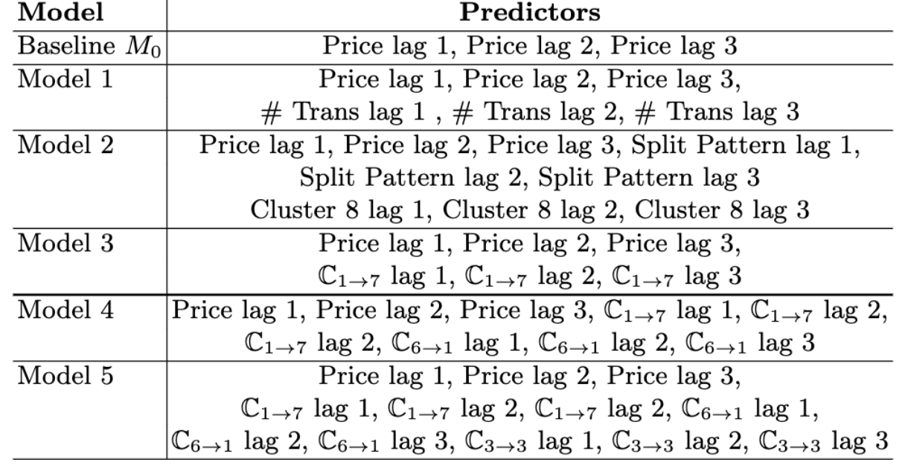
Paper 2:Forecasting Bitcoin Price with graph chainlet

Slide 30
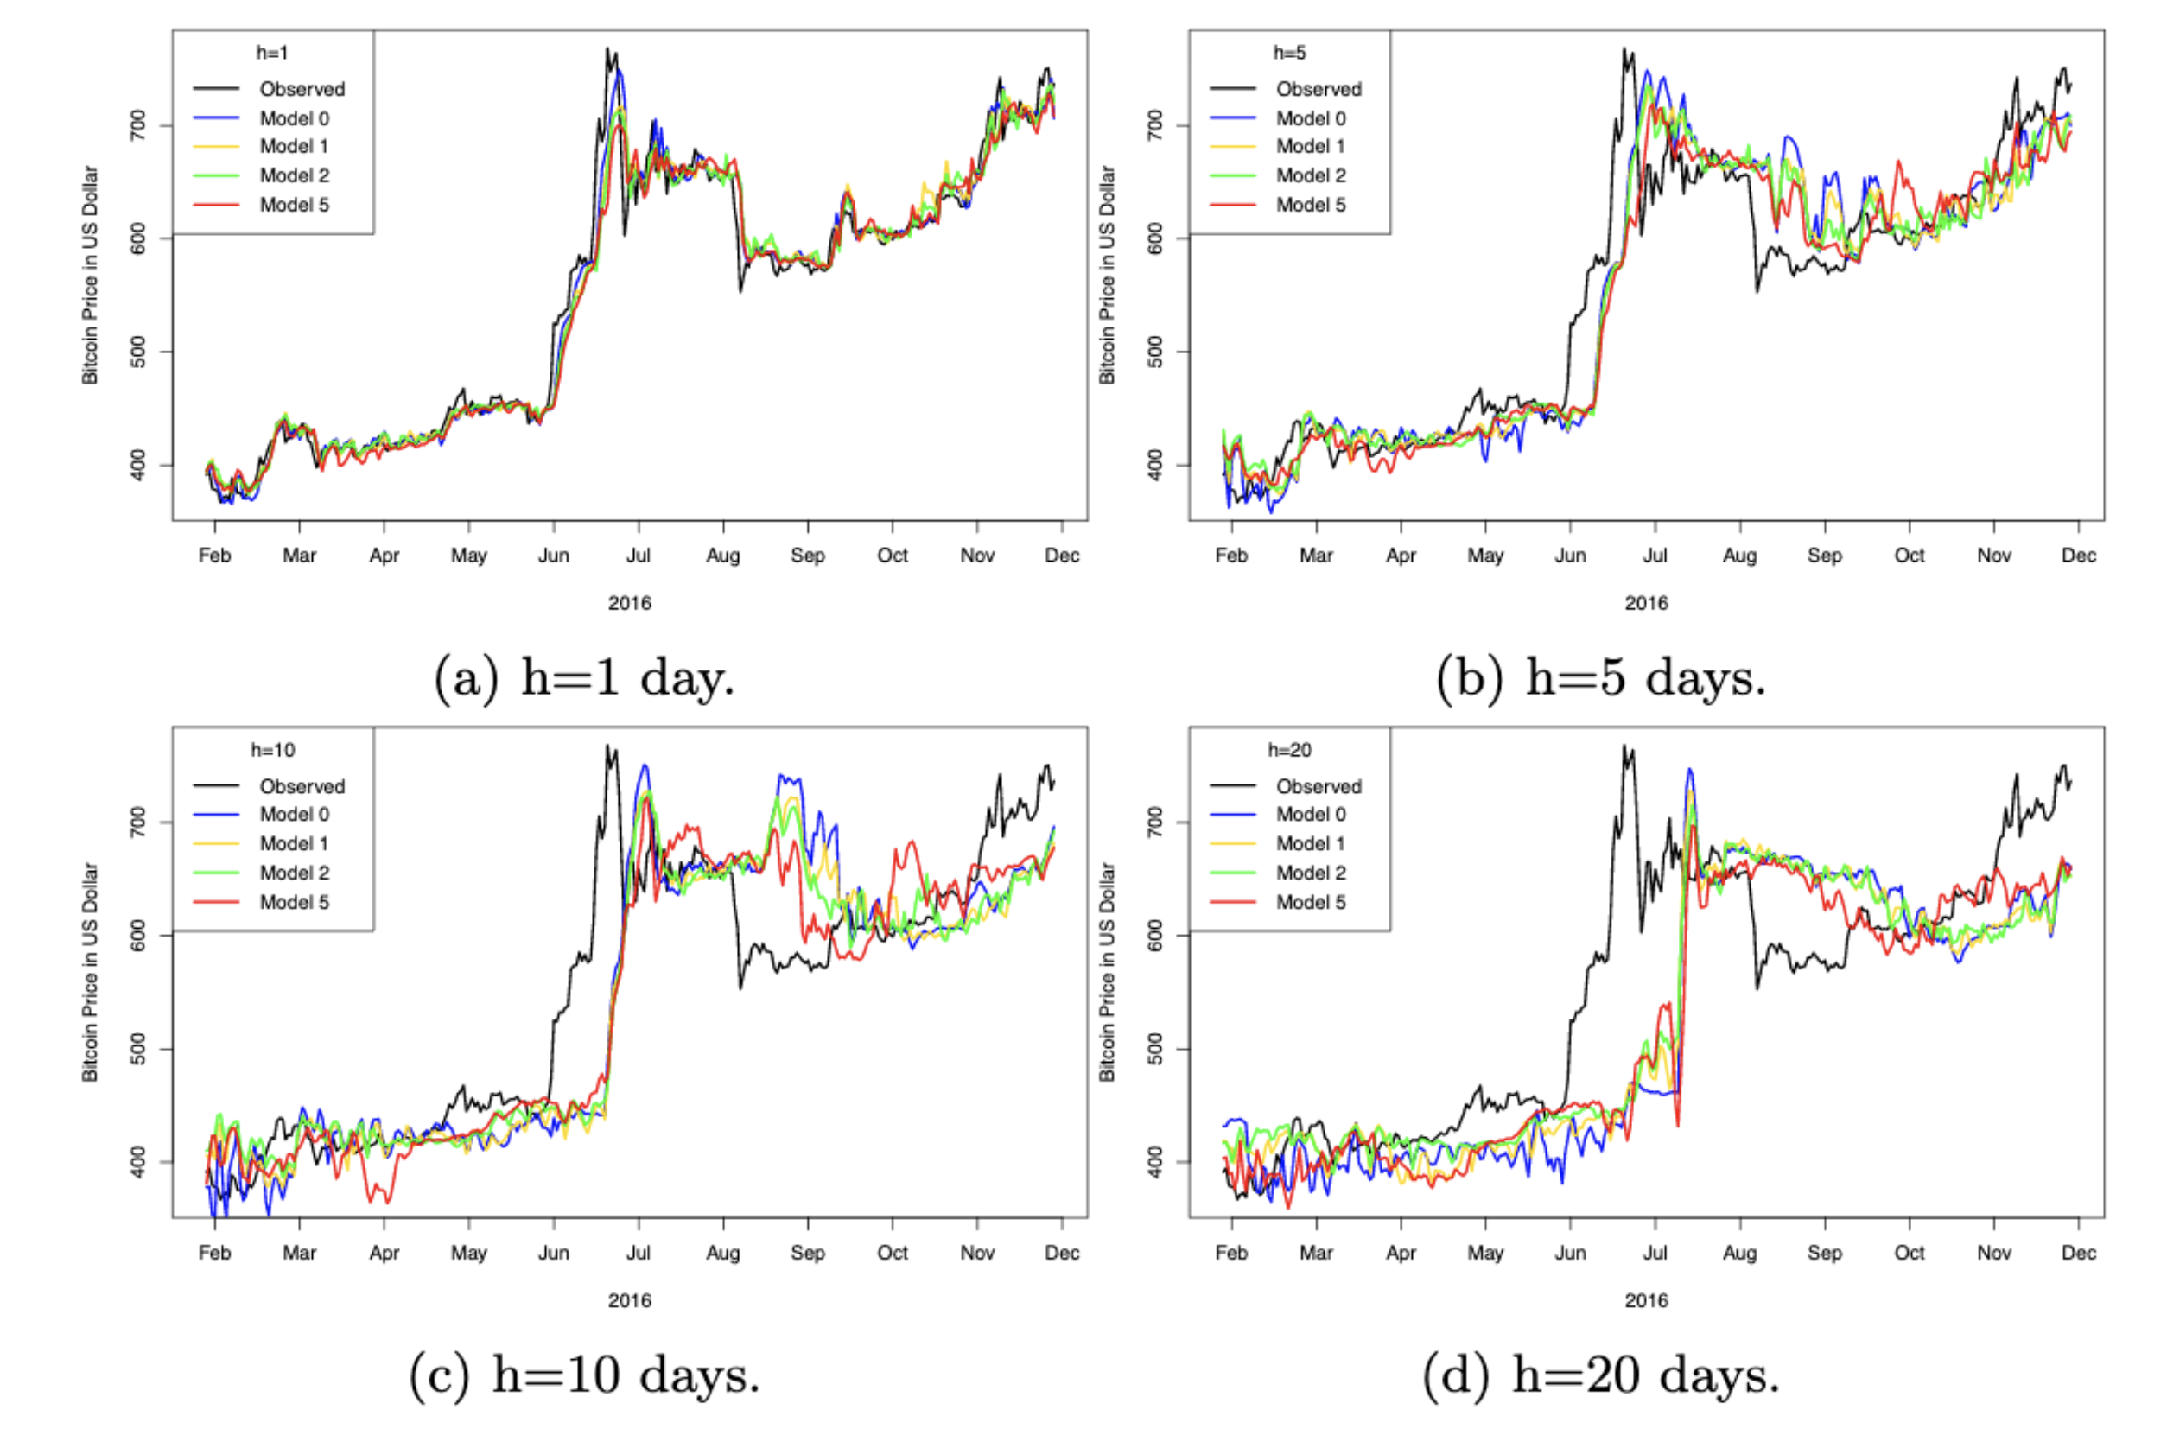
Paper 2:Forecasting Bitcoin Price with graph chainlet

Slide 31
Question
Do you think the data representation is apt for this prediction problem?
Would not it have been better if markov chain modeling or rnn was used for temporal prediction?

Slide 32
THANK YOU
If you have any questions please ask.

